Slide 1
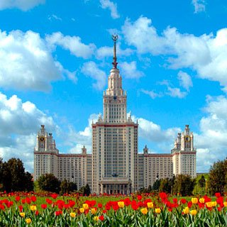
A Few Aspects of Teaching Russian to Japanese Students
O.N.Korotkova
Ph.D, Associate Professor,
M.V.Lomonosov Moscow State University

Slide 2
Japanese students
Doctoral students
contract programs
intensive courses
Master Students
individual programs
Study Abroad Students

Slide 3
O.K.Grekova, E.A Kuzminova. Discussing and Writing a Thesis. A Textbook for Foreigners Studying Russian. - M., 2003.
This textbook gives a general idea of how to write a thesis, how to write an author’s abstract and what to say during a thesis' defense.

Slide 4
O.K.Grekova, E.A Kuzminova. I Listen and Understand. A Textbook for Teaching Listening - M., 2003.
This textbook develops learners’ comprehension of Russian speech, teaching them to identify new information, understand it and produce it. This book centers around fragments of 15 lectures delivered by professors of the philological faculty of MSU.

Slide 5
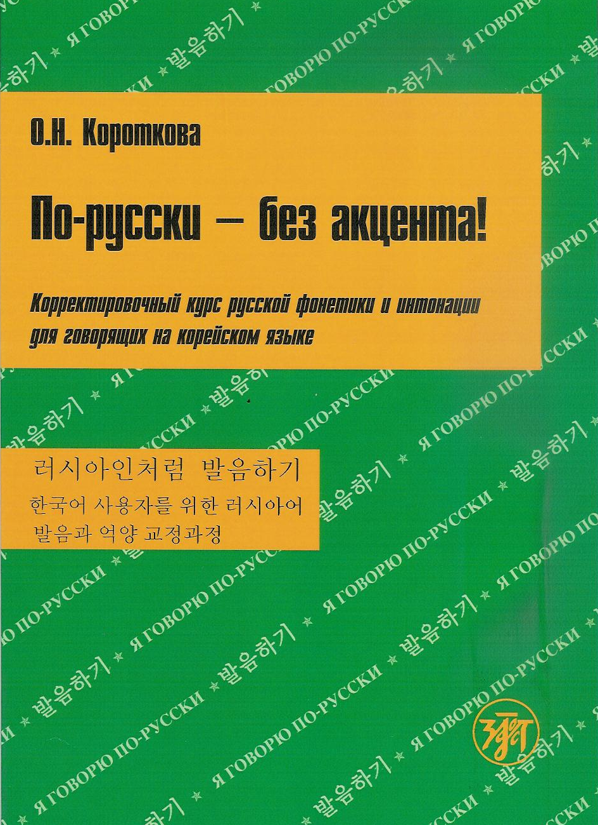
Speak Russian without an Accent! A Corrective Course of Russian Phonetics and Intonation for Chinese Students. – Petersburg, 2006.
Speak Russian without an Accent! A Corrective Course of Russian Phonetics and Intonation for Korean Students. – Petersburg, 2010.
? For Japanese students

Slide 6
Modern Russian Prose – XXI century. A reader for those who study Russian as a Foreign Language / ed. E.A Kuzminova, I.V.Ruzhitski. – M., 2009.
This book consists of stories of modern Russian writers. All texts included in this book are followed by commentaries of two types: I – lexical, stylistic and grammar commentaries, II – explanation of realia, names, and quotations that are important for understanding the text.

Slide 7
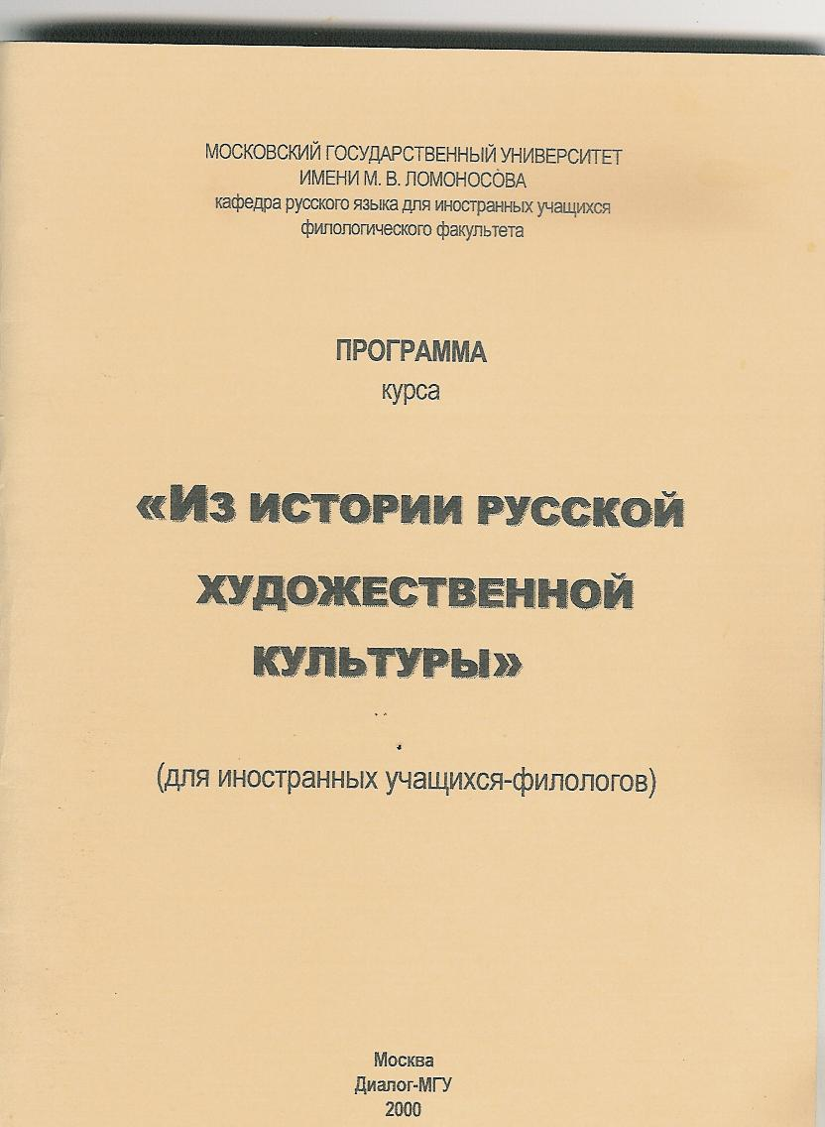
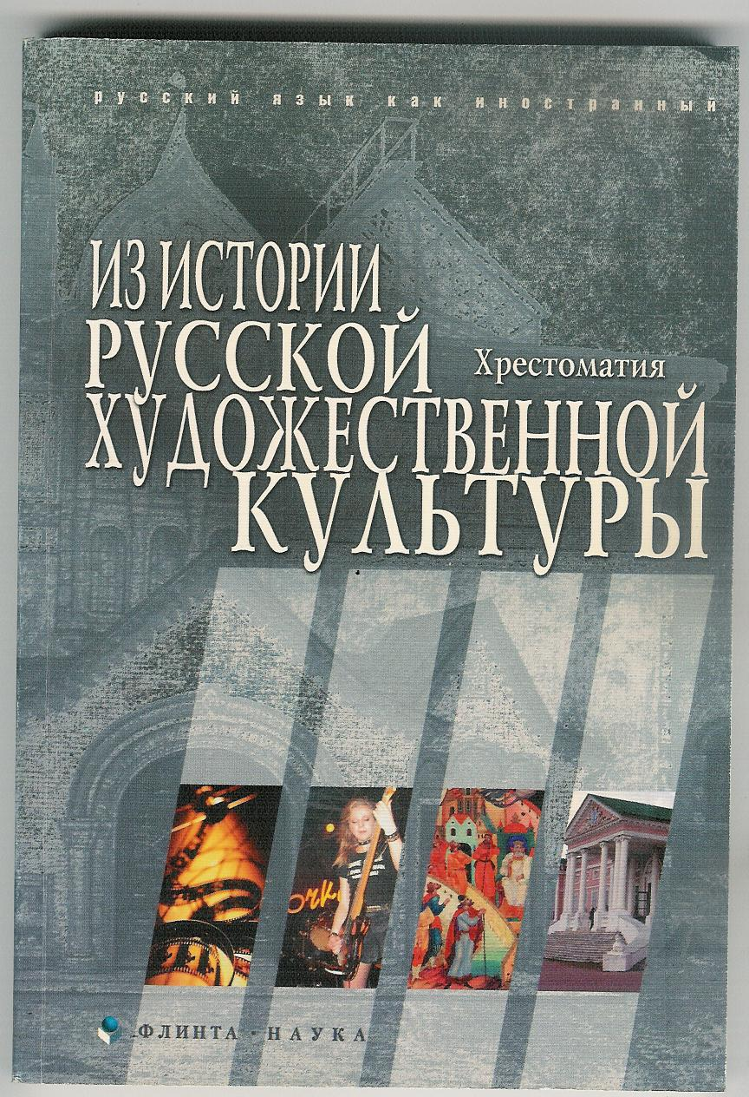
Russian Art Culture Studies
1. The Outline of the Course “From the History of Russian Art Culture” for Foreign Philologists / ed. L.N Kashezheva – M., 2000.
2. From the History of Russian Art Culture: a reader /ed. A.G. Lileeva, I.V.Ruzhitski. – M., 2006
3. From the History of Russian Culture: a reader /ed. A.G. Lileeva, I.V.Ruzhitski. – M., 2008.

Slide 8
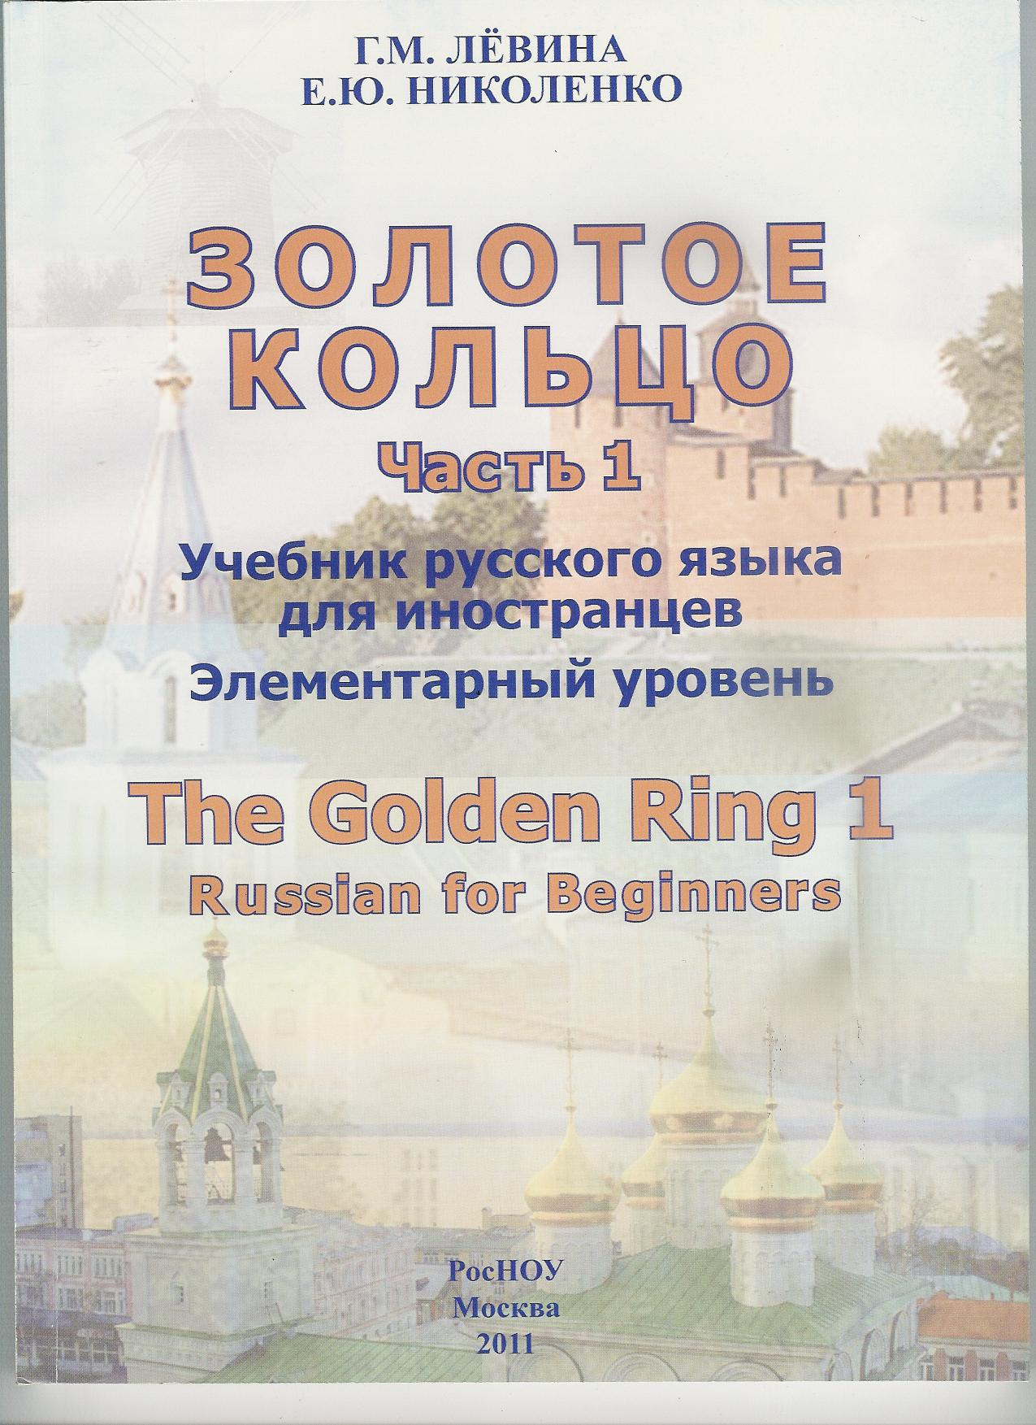
Russian for Beginners and Preintermediate Students
1. G.M. Levina, E. Ju. Nickolenko. The Golden Ring I: Russian for Beginners. – M., 2011
2. I.V. Odintzova What did you say? A book for developing foreign students' listening and speaking skills. – Petersburg, 2003.

Slide 9
Russian for Intermediate Students
1. O.N. Korotkova, I.V. Odintzova. Heart-to Heart Talk. A textbook on Russian Conversation. – M., 2003.
2. O.N. Korotkova, I.V. Odintzova. Make a wish! A textbook on Russian Conversation. 2-nd edition. – M., 2010.

Slide 10
Спасибо за внимание!
Thank you for your attention!
ご清聴ありがとうございました!

